Slide 1
Fraud Detection
Bala Daks

Slide 2
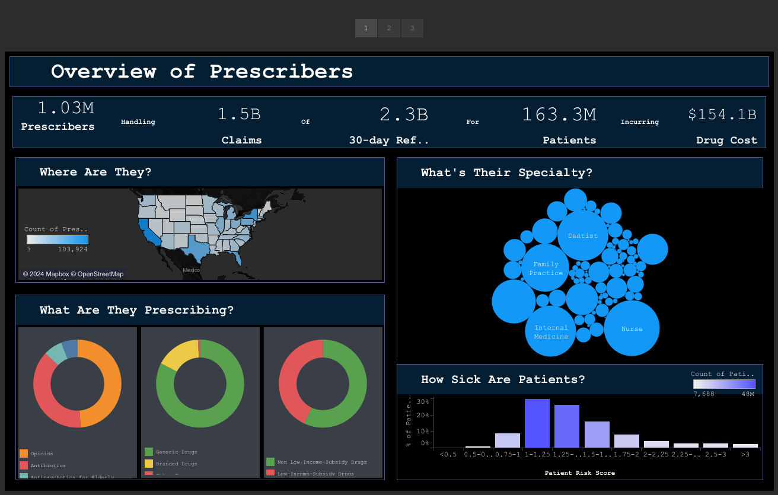

Slide 3
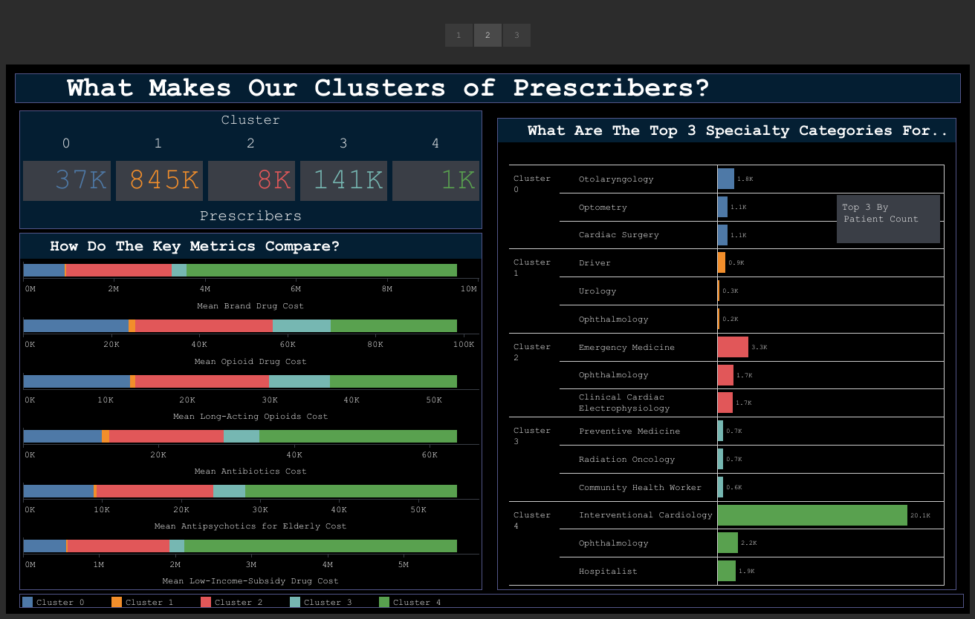

Slide 4
